Slide 1
File handling in python

Slide 2
Some rules
Mode | Description
“r” | Read mode. Opens a file for reading. Raises an error if the file does not exist.
“w” | Write mode. Opens a file for writing. If the file exists, it truncates (clears) the file before writing. If the file doesn’t exist, it creates a new file.
“x” | Exclusive creation mode. Opens a file for exclusive creation. If the file already exists, it raises a FileExistsError exception.
“a” | Append mode. Opens a file for appending data. The file pointer is at the end of the file, so the contents are added to the end. If the file doesn’t exist, it creates a new file.
“b” | Binary mode. Opens a file in binary mode for reading or writing binary data. This mode is typically used for non-text files like images or binary data.
“t” | Text mode. Opens a file in text mode, which is the default mode. This mode is used for reading or writing text data.
“+” | Read and write mode. Adds the ability to read and write to a file. For example, "r+" opens a file for both reading and writing.

Slide 3
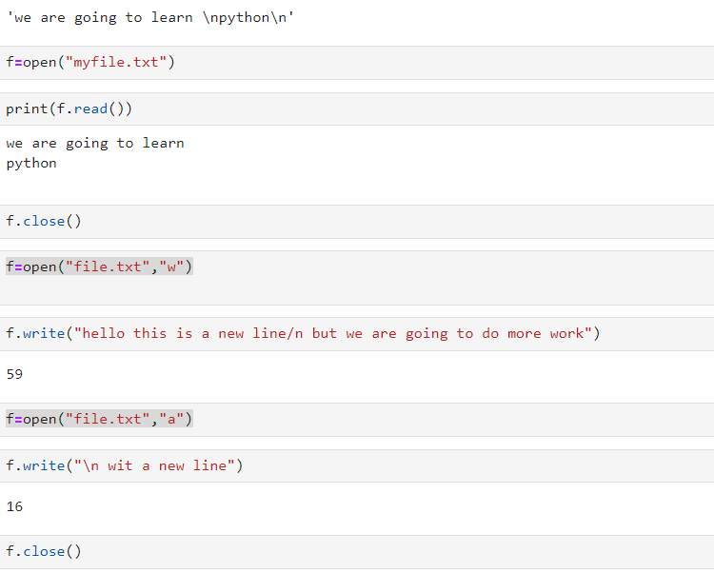
How to open a txt file
f=open("myfile.txt") #if already exist in the same folder
f.read()
3

Slide 4
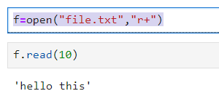
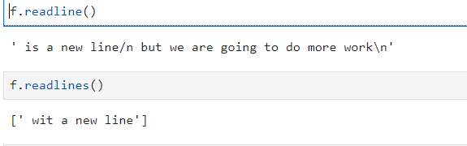
Read to some limit
If we give limit beyond a single line capacity then no gain….
But if use readline() after writing read(10) then the pointer will point to next text

Slide 5
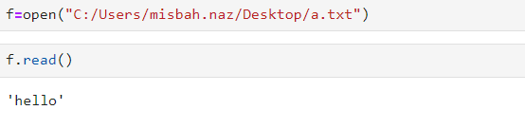
Open a file from another path

Slide 6
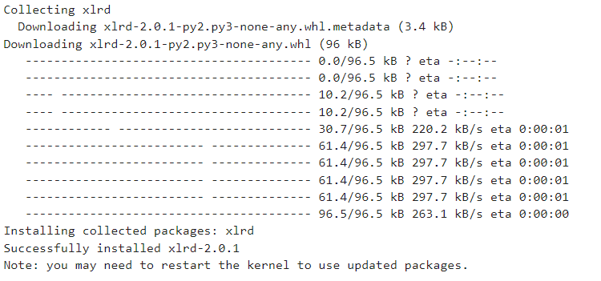
Open a xlsx file
For this we have to write following command to install the required module
pip install xlrd
Execute this command

Slide 7
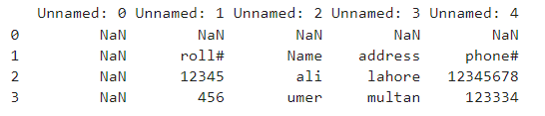
Method1: Reading an excel file using Python using Pandas
# import pandas lib as pd
import pandas as pd
# read by default 1st sheet of an excel file
data = pd.read_excel(‘data.xlsx')
print(data)

Slide 8
Method 2: Reading an excel file using Python using openpyxl
Output
Roll#
# import openpyxl module
import openpyxl
# Give the location of the file
path = “data.xlsx"
# To open the workbook
# workbook object is created
wb_obj = openpyxl.load_workbook(path)
# Get workbook active sheet object
# from the active attribute
sheet_obj = wb_obj.active
cell_obj = sheet_obj.cell(row=1, column=1)
print(cell_obj.value)

Slide 9
Python Openpyxl Read multiple cells
import openpyxl
# Give the location of the file
path = “data.xlsx"
wb_obj = openpyxl.load_workbook(path)
sheet_obj = wb_obj.active
row = sheet_obj.max_row
column = sheet_obj.max_column
print("Total Rows:", row)
print("Total Columns:", column)
print("\nValue of first column")
for i in range(1, row + 1):
cell_obj = sheet_obj.cell(row=i, column=1)
print(cell_obj.value)
print("\nValue of first row")
for i in range(1, column + 1):
cell_obj = sheet_obj.cell(row=2, column=i)
print(cell_obj.value, end=" ")
Total Rows: 3
Total Columns: 4
Value of first column
roll#
12345
456
Value of first row
12345 ali lahore 12345678
Reading through Rows and Columns in Excel with openpyxl

Slide 10
Read from Multiple Cells Using the Cell Name
roll# Name address
12345 ali lahore
456 umer multan
345 hira lahore
import openpyxl
# Give the location of the file
path = “data.xlsx"
wb_obj = openpyxl.load_workbook(path)
sheet_obj = wb_obj.active
cell_obj = sheet_obj['A1’: ‘C4’]
for cell1, cell2, cell3 in cell_obj:
print(cell1.value, cell2.value,cell3.value)

Slide 11
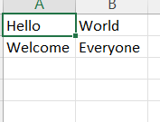
Python Write Excel File
# import openpyxl module
import openpyxl
wb = openpyxl.Workbook()
sheet = wb.active
c1 = sheet.cell(row=1, column=1)
# writing values to cells
c1.value = "Hello"
c2 = sheet.cell(row=1, column=2)
c2.value = "World"
c3 = sheet['A2']
c3.value = "Welcome"
# B2 means column = 2 & row = 2.
c4 = sheet['B2']
c4.value = "Everyone"
wb.save("sample.xlsx")
from openpyxl import Workbook
workbook = Workbook()
workbook.save(filename="sample.xlsx")

Slide 12
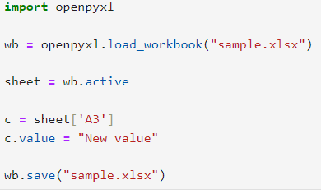
Append data in excel using Python
you will see that every time you try to write to a spreadsheet the existing data gets overwritten, and the file is saved as a new file. This happens because the Workbook() method always creates a new workbook file object. To write to an existing workbook you must open the file with the load_workbook() method

Slide 13
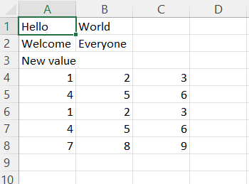
Continue….
import openpyxl
wb = openpyxl.load_workbook("sample.xlsx")
sheet = wb.active
data = (
(1, 2, 3),
(4, 5, 6) ,
(7,8,9)
)
for row in data:
sheet.append(row)
wb.save('sample.xlsx')

Slide 14
Arithmetic operations
import openpyxl
wb = openpyxl.Workbook()
sheet = wb.active
# writing to the cell of an excel sheet
sheet['A1'] = 200
sheet['A2'] = 300
sheet['A3'] = 400
sheet['A4'] = 500
sheet['A5'] = 600
sheet['A7'] = '= SUM(A1:A5)'
# save the file
wb.save("sum.xlsx")
200
300
400
500
600
2000

Slide 15
Adjusting Rows and Column
# import openpyxl module
import openpyxl
wb = openpyxl.Workbook()
sheet = wb.active
# writing to the specified cell
sheet.cell(row=1, column=1).value = ' hello '
sheet.cell(row=2, column=2).value = ' everyone '
# set the height of the row
sheet.row_dimensions[1].height = 70
# set the width of the column
sheet.column_dimensions['B'].width = 20
# save the file
wb.save('sample.xlsx')
hello
 | everyone

Slide 16
Merging Cells
import openpyxl
wb = openpyxl.Workbook()
sheet = wb.active
sheet.merge_cells('A2:D4')
sheet.cell(row=2, column=1).value = 'Twelve cells join together.'
# merge cell C6 and D6
sheet.merge_cells('C6:D6')
sheet.cell(row=6, column=6).value = 'Two merge cells.'
wb.save('sample.xlsx')

